Slide 1

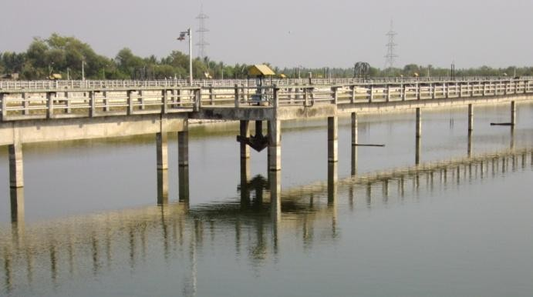
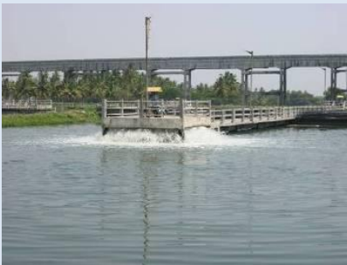
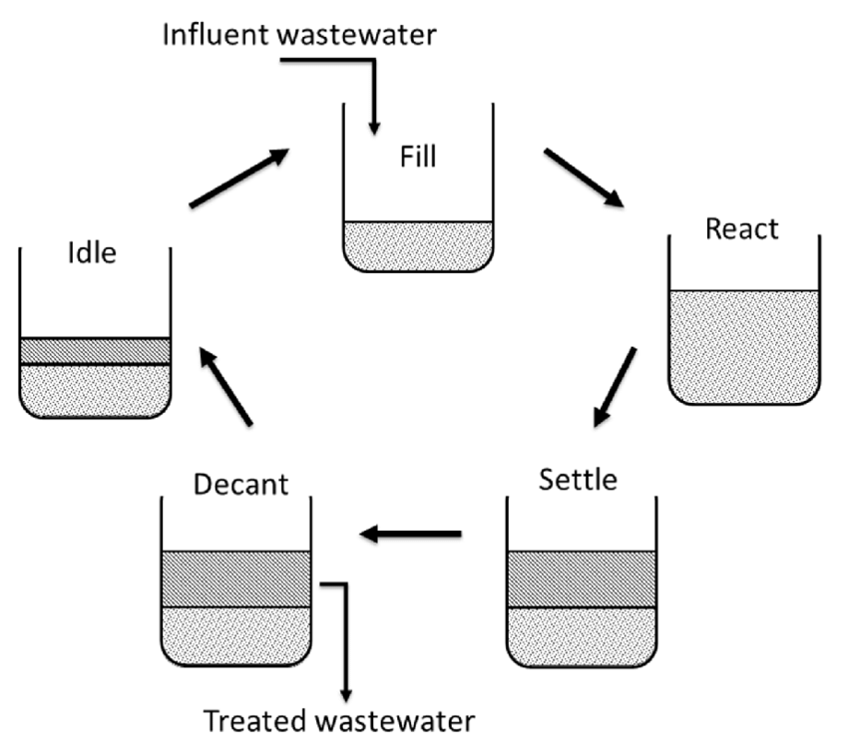
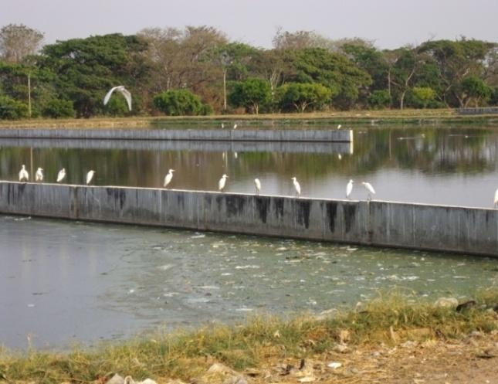
2.SEWAGE GENERATION
URBAN CORE INFRASTRUCTURE
Sewage Generation
To Protect Public Health.
Environmental Preservation & Pollution Reduction.
Integrated City-Wide Sanitation
Sanitary and Safe Disposal
SBR Reactor:
The Sequencing Batch Reactor is a type of activated sludge process for wastewater treatment where the processes occur in a single tank in sequential steps.
How It Works:
SBR operates in cycles, with each cycle consisting of five stages:
1.Fill: Wastewater enters the reactor.
2.React (Aeration): Air is supplied to promote microbial activity that breaks down organic matter.
3.Settle: Aeration stops, and solids settle at the bottom of the tank.
4.Decant: The treated water (supernatant) is removed. 5.Idle: The reactor prepares for the next cycle.
Applications:
SBR is used for municipal and industrial wastewater treatment, particularly where flow rates or loadings vary.
Vidyaranyapuram STP Kesare STP
Rayanakere STP
SCHOOL OF PLANNING AND ARCHITECTURE
NAME: MAHAM KAUSAR
REV/EXM:03
DISTRICT DEVELOPMENT PLAN FOR MYSURU DISTRICT
CLASS:3rd Sem, MTech in URP
DRW:03
REG NO:P01ZZ23T107004

